Slide 1

APPL STOCK PRICE PREDICTION
BY DIPAK PAKHALE

Slide 2
CONTENTS
1.INTRODUCTION
2.PROJECT DETAILS
3.OBJECTIVES
4.PLANNING
5.WORKFLOW
6.TOOLS AND PLATFORMS USED
7.CHALLENGES
8.CONCLUSION
The more amazing works designed by CICI. We try our best to do better in business and our living life.

Slide 3
INTRODUCTION
APPL IS APPLES STOCK NAME ON WHICH I HAVE APPLIED TIME SERIES ALGORITHMS AND PREDICTEDTHE PRICE OF STOCK.
WITH THE USE OF THE PREDICTED VALUES WE CAN DECIDE WHETHER IS COMPANYS GOING TO BE PROFITABLE OR FACING LOSS
SO THIS FORCASTED VALUES PLAYES IMPORTANT ROLE WHILE ANYALYSING THE SALES OF COMPANY

Slide 4
PROJECT DETAILS
I HAVE CHOOSE THE APPLE COMPANYS SHARES DATA TO FORCAST
SO TO FORCAST I HAVE COLLECTED THE DATA OF APPL STOCK PRICE
FROM 1-11-1999 TO 6-4-2023 WHICH WAS LATEST
WITH USE OF WEB SCRAPING I HAVE GENERATED DATA AND CONVERTED
INTO SUITABLE FORMAT
AFTER THAT I HAVE APPLIED TIME SERIES ALGORITHYMS TO PREDICT
I HAVE COMPARED WITH LIVE DATA

Slide 5
OBJECTIVES
MAIN OBJECTIVE IS TO FORCAST ACCURATE THE PRICE OF STOCK
SECONDARY OBJECTIVE IS TO COMPARAE WITH STOCK PRICES

Slide 6
PLANNING
PEDICT
MODEL BUILDING
PROCESSING
DATA
FORCAST THE OUTPUT
CHOOSE THE FORCASTING
ALGORYTHM
CONVERT INTO SUITABLE FORMAT
DATA COLLECTION

Slide 7
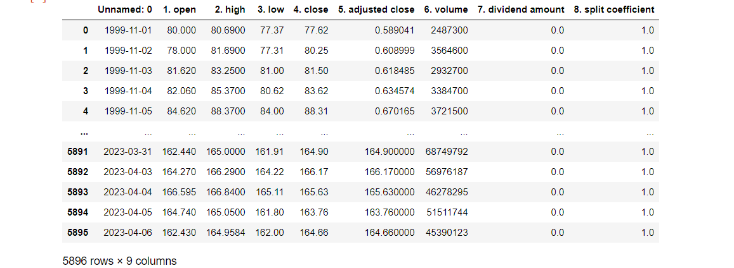
WORKFLOW
1.FIRST I HAVE COLLECTED DATA OF APPL STOCK WITH WEB SCRAPPING AND SAVED IN TABLE FORMAT

Slide 8
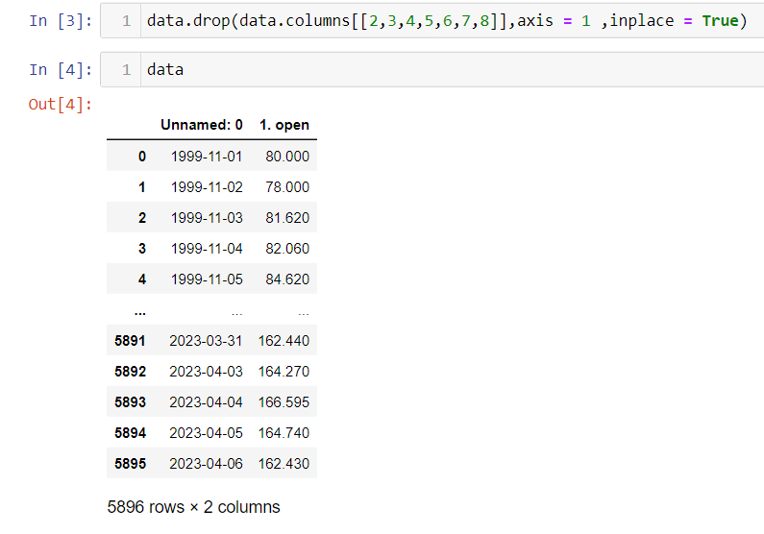
WORKFLOW
2. I HAVE REMOVED THE OTHER VARIABLES AND JUST KEPT A SINGLE VARIABLE AND DATE

Slide 9
WORKFLOW
DATA COLLECTION
CONVERSION OF DATA INTO USEFUL FORMAT
REMOVE THE UNWANTED VARIANBLES
SELECT THE DATA AND SPLIT INTO TRAIN TEST
ANYALYS THE TREND
ACCORDINGLY SELECT THE ALGORYTHM
CHECK THE FORCASTED VALUES AND LIVE VALUES
FORCAST THE VALUES
PLOT THE GRAPH
OF FORCASTED VALUES

Slide 10


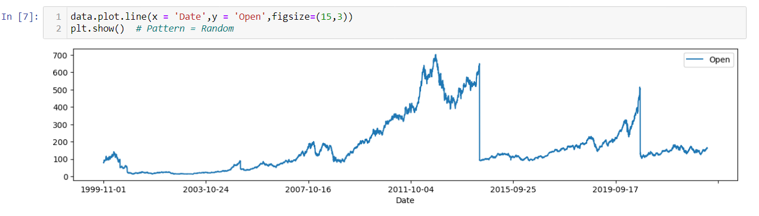
TOOLS AND PLATFORMS USED
TOOL IS JUPYTER
CODES USED IN PYTHON
ALGORYTHM IS FORCASTING

Slide 11
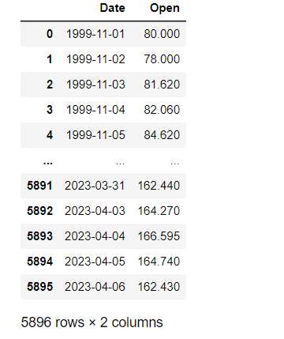
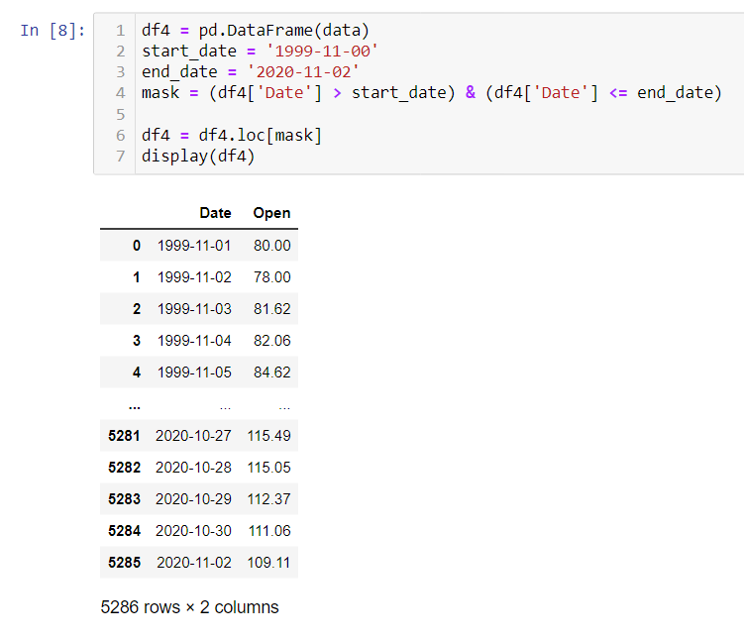
DATA PROCESSING
FROM 5896 ROWS I HAVE SELECTED THE 5286 ROWS AND REST WILL BE OUR
LIVE DATA FOR CHECKING
I HAVE SELECTED FROM 1999-2020 DATA ONLY

Slide 12
MODEL USED
TO FORCAST THE OUTPUT I HAVE SELECTED ARIMA MODEL
ARIMA stands for Autoregressive Integrated Moving Average. It is a popular time series analysis technique used for forecasting future values based on historical trends and patterns in the data.
ARIMA models are typically used for stationary time series data, meaning data that has a constantmean and variance over time. They can handle data with trends, seasonality, and other patterns, and are particularly useful for modeling economic and financial data, as well as other types of time series data.
ARIMA models are also useful for detecting and removing trends, seasonality, and other patterns from timeseries data, which can be helpful in improving the accuracy of forecasting models.

Slide 13
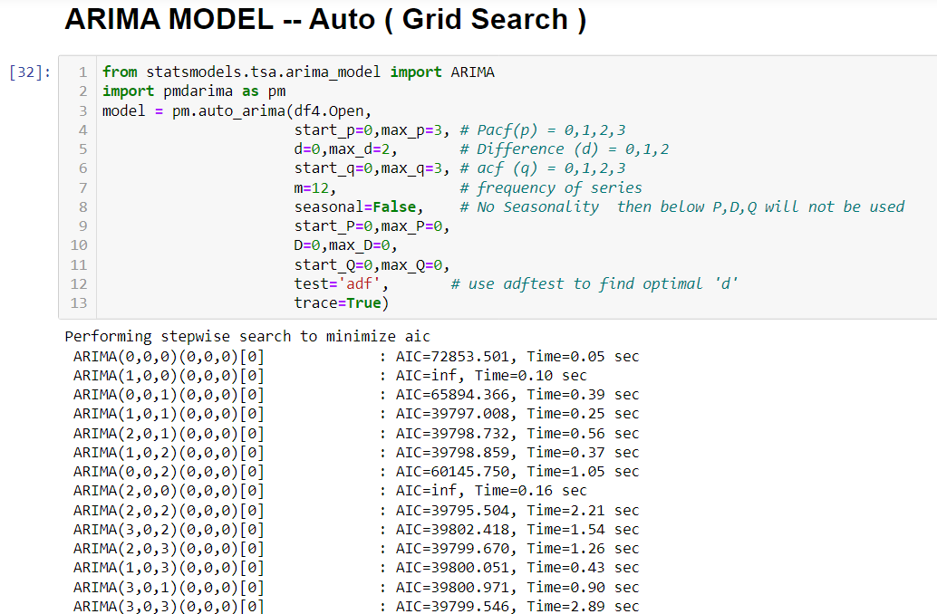
MODEL USED

Slide 14
CHALLENGES
1.CHALLANGE WAS TO COLLECT THE LIVE DATA AND MAKE IT INTO THE ALGORYTHM SUITABLE SO TO COLLECT AND
MAKE IT USABLE I HAVE DONE WEB SCRAPPING AND SAVED DATA AND AFTER PROCESSING I HAVE SAVED IN THIS
TABLE FORMAT
2.ANOTHER CHALLENGE WAS TO SELECT THE EXPONETIAN SMOOTHING AS DATA WAS VERY FLUCTUATIN TYPE
WITH THE USE OF GRAPH I HAVE DECIDED TO USE THE ARIMA
3.AND THE MAJOR CHALLENGE WAS THE HOW TO CHECK THE PREDICTIONS VALUES SO FOR THAT I HAVE SPLITTED
DATA INTO 70-30 FORMAT

Slide 15
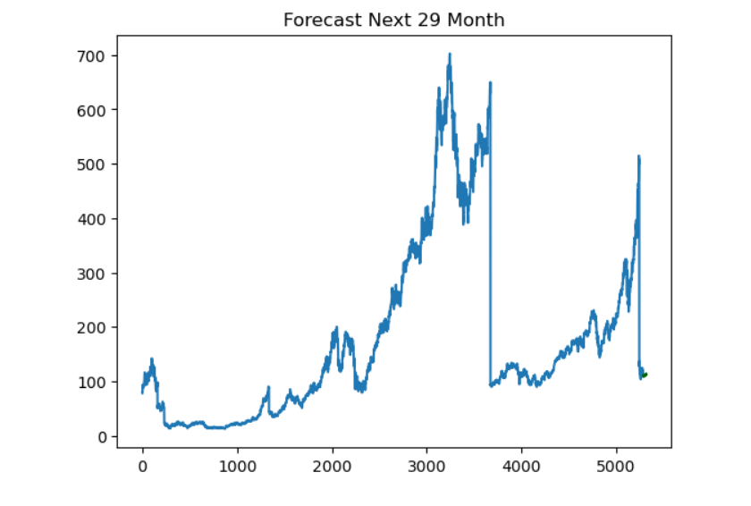
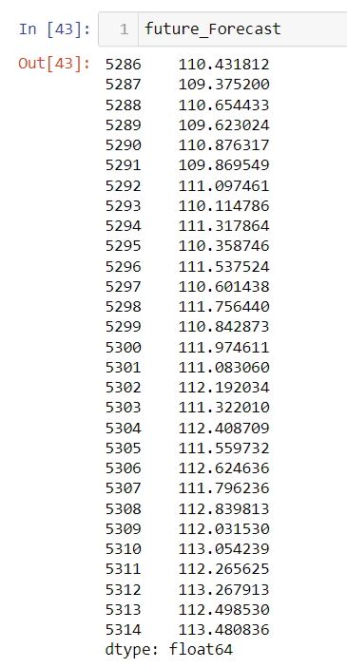
CONCLUSION
WITH HELP OF ARIMA I HAVE PREDICTED THE PRICE OF STOCKS

Slide 16
Thank You!

